Slide 1
Topic: Electrical Energy Management with Internet of Things Technologies
Presented by:
Vimal Jaswal - B00122875
Masters of Engineering in Internet of things technologies
Institute of Technology Blanchardstown, Dublin, Ireland.

Slide 2
Electrical Energy Management and IOT
IOT Applications – smart devices, smart buildings, smart services, smart cities, smart health, smart transportation, smart farming, smart grids etc.
New information and communication technology (ICT): Internet of things, big data and cloud computing.
Major Dependencies: Data Centers and Electrical Energy Demand.
“computing practice has moved away from hardware-specific computing toward --the network is the device “
What would be the effect on Data Centers and Electric Energy Sources?
Future Necessities: Uninterrupted Continuous energy Availability, Energy Resilience, Stability, Outage Management.
References:
MacNamara, C., Browne, J.J., Bowhill, W.J., Nolan, C., Marjanovic, N., Sexton, R., Agnew, P. and Hanily, C., Intel Corp, 2018. Data Center Power Management. U.S. Patent Application 15/601,296.

Slide 3
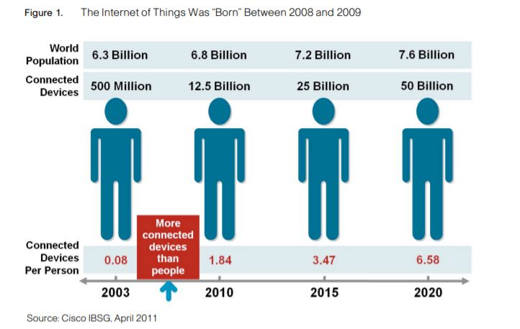
Problem statement/objectives
Probably the demand for electric energy in data centers and other industrial internet and software organisations will boom in future with IOT.
Proposed Solution and Objective:
To develop Electrical energy management software that can be connected with every IOT application field.
Dividing every big unit (data center/buildings) in small sub-energy units.
Collaborating and then analysing and managing these isolated energy units through one API.
To ensure efficient uninterrupted availability of energy supply for smart services and outages alternatives.

Slide 4
Research Methodologies
Survey: Prediction of upcoming IOT application services and growth of electric energy demand in future.
Design of Experiment: Designing software models for Electric Energy Management utilising current internet of things resources.
Testing and Refining design models.
Data Analysis/Regression Analysis: Calculation of Significance of experimental observations obtained by above .
Analysing Impact: forecasting issues and future research impacts in this context.

Slide 5
Workplan
Method 1:
Action Steps | Timeline (2018-2019) | Observations/Reports | Evaluation/Review | Comments
Prediction of upcoming IOT application services and growth of electric energy demand in future. | Dec-Jan
Method 2:
Action Steps | Timeline (2018-2019) | Observations/Reports | Evaluation/Review | Comments
Designing software models for Electric Energy Management utilising current internet of things resources. | February
Method 3:
Action Steps | Timeline (2018-2019) | Observations/Reports | Evaluation/Review | Comments
Testing and Refining design models. | March
Method 4:
Action Steps | Timeline (2018-2019) | Observations/Reports | Evaluation/Review | Comments
Data Analysis/Regression Analysis | April
Method 5:
Action Steps | Timeline (2018-2019) | Observations/Reports | Evaluation/Review | Comments
Analyzing Research Impact | May
Method 6:
Action Steps | Timeline (2018-2019) | Observations/Reports | Evaluation/Review | Comments
Preparation of Thesis/dissertation, Research paper, Project | June-July-August

Slide 6
Thanks.

